Slide 1
EFFECTIVE HEART DISEASE PREDICTION USING Random forest MACHINE LEARNING TECHNIQUE

Slide 2
Group Member Information
1. Midhun Kumar, Chintapalli – 700739502
2. Venkata Suraj, Gamini – 700744962
3. Pavan Kalyan, Pinniboina – 700747583
4. Kundana, Yerragonda – 700748505

Slide 3
Role/Responsibilities and Contribution in project
Midhun- Implementation of Logistic Regression, Naïve Bayes, Support Vector Machine
Suraj-Implementation of K-Nearest Neighbors, Decision Tree, Random Forest
Pavan Kalyan-Implementation of XGBoost, Artificial Neural Network with 1 hidden layer
Kundana- Dataset

Slide 4
INTRODUCTION
Heart disease is a leading cause of death worldwide and is a major public health concern. Early detection and accurate prediction of heart disease can significantly improve patient outcomes and reduce healthcare costs. Traditional methods of heart disease diagnosis rely on clinical tests and medical history, which can be time-consuming and expensive. Machine learning offers a promising alternative approach to predict heart disease using readily available patient data. By using machine learning algorithms to analyze patient data. We can develop accurate predictive models that can identify patients at risk of heart disease. The ability to accurately predict heart disease using machine learning can provide healthcare providers with a valuable tool to improve patient care, prevent complications, and reduce healthcare costs. This project has the potential to make a significant impact on public health and improve patient outcomes, making it a highly motivating and worthwhile pursuit.

Slide 5
OBJECTIVES
Data collection and preprocessing:
Gather a large, diverse, and representative dataset of individuals with various demographic, clinical, and lifestyle factors.
Feature selection:
Identify the most relevant and significant features for heart disease prediction, such as age, sex, blood pressure, cholesterol levels, smoking habits, and family history.
Model selection and evaluation:
Choose appropriate machine learning algorithms for the task,
Split the dataset into training and test sets to ensure unbiased evaluation of model performance.
Evaluate model performance using appropriate metrics like accuracy.
By achieving these objectives, an effective heart disease prediction model can be developed using machine learning techniques,

Slide 6
ReLATED WORK
"Heart disease prediction using a hybrid machine learning approach" by Ghosh et al. (2020) - This study proposes a hybrid machine learning approach that combines feature selection techniques with classification algorithms to improve the accuracy of heart disease prediction. The authors compare their approach with several other algorithms and demonstrate its effectiveness.
A machine learning approach for predicting heart disease using demographic and clinical data" by Khera et al. (2019) - In this study, the authors develop a machine learning model to predict heart disease using demographic and clinical data from a large electronic health record database. The model achieves high accuracy and could be useful for identifying high-risk patients.

Slide 7
Problem statement
Heart disease is one of the leading causes of death globally. Early detection and accurate prediction of heart disease can significantly improve patient outcomes and reduce healthcare costs. Machine learning techniques have the potential to assist in predicting the risk of heart disease by analysing patient data.

Slide 8
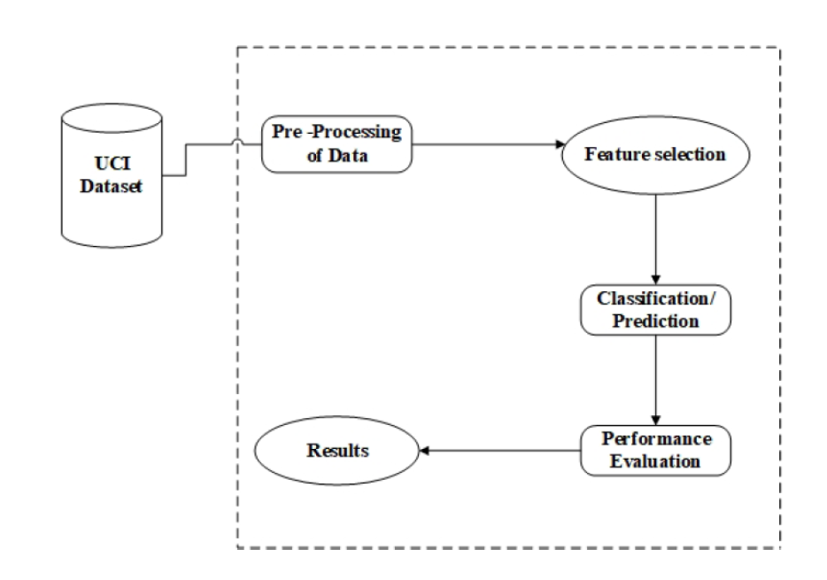
Proposed Solution
Logistic Regression
Naïve Bayes
SVM
K Nearest Neighbor
Decision Tree
Random Forest
XGBoost

Slide 9
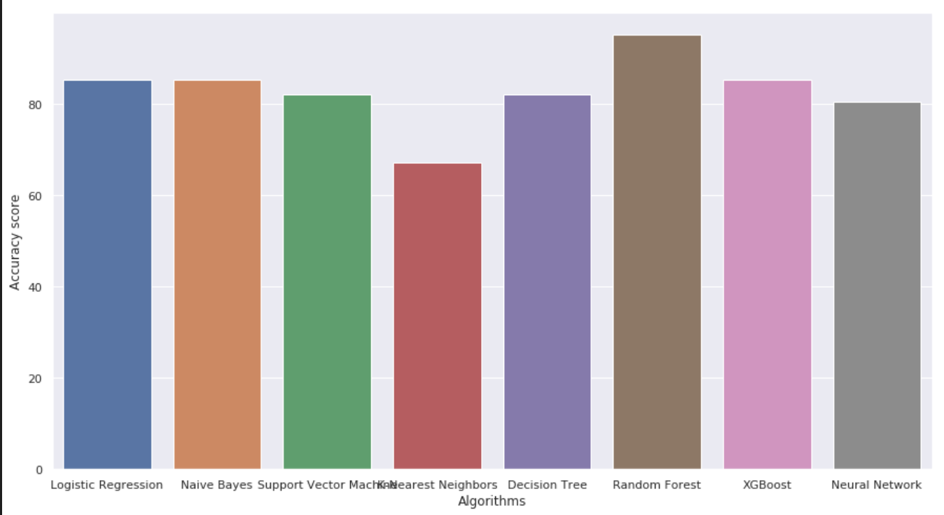
Results

Slide 10
Conclusion
After comparing all the Machine learning algorithms, The random forest algorithm achieved an
accuracy of 95.08%, which is higher than the accuracy of logistic
regression (85.25%), Naive Bayes(85.25%), SVM (81.97%),
K-NN(67.21%), Decision Tree(81.97%), XGBoost(85.25%) and
Neural Network(80.33%)

Slide 11
References
1. Rehman, S., Rehman, E., Ikram, M. et al. cardiovascular disease (CVD): assessment, prediction, and policy implications. BMC Public Health 21, 1299 (2021). https://doi.org/10.1186/s12889-021-11334-2.
2. Apurv Garg, Bhartendu Sharma and Rijwan Khan, Heart disease prediction using machine learning techniques, Apurv Garg et al 2021 IOP Conf. Ser.: Mater. Sci. Eng. 1022 012046, DOI 10.1088/1757-899X/1022/1/012046.
3. S. Mohan, C. Thirumalai, and G. Srivastava, "Effective Heart Disease Prediction Using Hybrid Machine Learning Techniques," in IEEE Access, vol. 7, pp. 81542- 81554, 2019, doi: 10.1109/ACCESS.2019.2923707.
4. M. Kavitha, G. Gnaneswar, R. Dinesh, Y. R. Sai, and R. S. Suraj, "Heart Disease Prediction using Hybrid machine Learning Model," 2021 6th International Conference on Inventive Computation Technologies (ICICT), Coimbatore, India,2021, pp.1329-1333, doi: 10.1109/ICICT50816.2021.9358597.
5. S. Kalta and R. Bhatt, "A Comparison Analysis of Heart Disease Dataset Using Decision Tree and Back-Propagation Network," 2021 Sixth International Conference on Image Information Processing (ICIIP), Shimla, India, 2021, pp. 556-561, doi: 10.1109/ICIIP53038.2021.9702667.
6. A. Singh and R. Kumar, "Heart Disease Prediction Using Machine Learning Algorithms," 2020 International Conference on Electrical and Electronics Engineering (ICE3), Gorakhpur, India, 2020, pp. 452-457, doi: 10.1109/ICE348803.2020.9122958.
7. P. Ghosh et al., "Efficient Prediction of Cardiovascular Disease Using Machine Learning Algorithms With Relief and LASSO Feature Selection Techniques," in IEEE Access, vol. 9, pp. 19304-19326, 2021, doi: 10.1109/ACCESS.2021.3053759.

